Slide 1
Assessment & Curriculum KS2
Using assessment to ensure children make progress in the curriculum.
Barnston Primary School
Tuesday 27th September 2022

Slide 2
Formative Assessment
The daily use of assessment to inform teaching and personalise learning.
Summative Assessment
The use of teacher assessment over a period of time to inform termly progress data.
Formative and summative assessment. Barnston Primary School

Slide 3
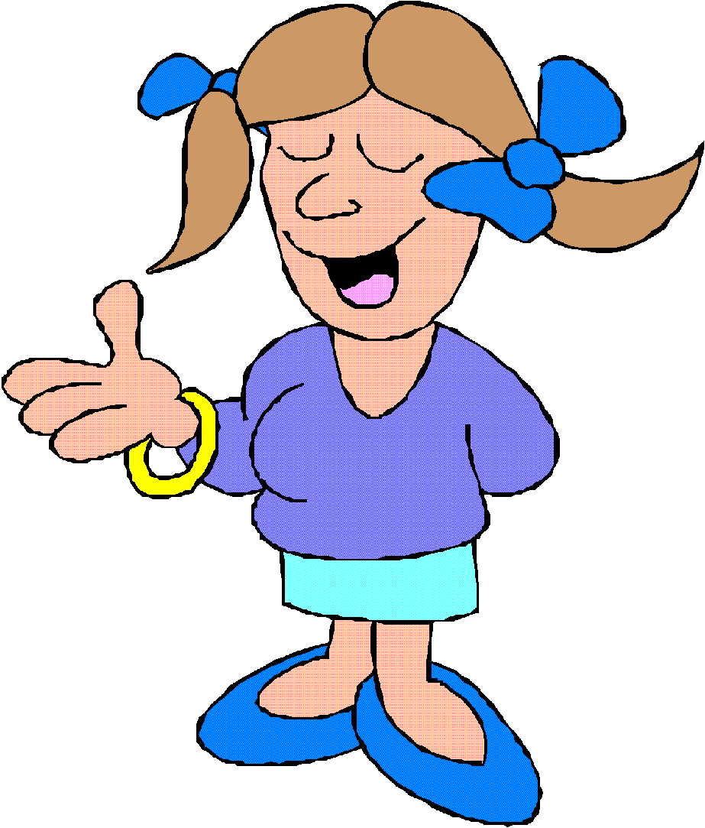
Assessment & Curriculum KS2
Em
Exp
Exc
Em
Exp
Exc
Em
Exp
Exc
Em
Exp
Exc
Em
Exp
Exc
End of Year 2/KS1
Higher level Y2 exceeding
KS2 begins
JANE
End of Year Three
Higher level Y3
Em
Exp
Em
Exp
Exc
ELGs end of F2
KS1 begins
End of Year Four
Higher level Y4 exceeding
End of Year One
Higher level Y1 exceeding
End of Year five
Higher level Y5 exceeding
End of Year 6/KS2 (gaps still)
End of Y6 expected & ready
End of Y6 higher level exceeding
Notes:
3
Statutory tests at Yr 2 and Yr 6. Non statutory to establish what level a child is working at: tested at Feb and July to monitor progress over a year – expected 2 sub levels progress. Data booklets have been used to record and track the children’s progress on these assessments.

Slide 4
Tracking Children’s Progress in the Curriculum
Year 3 Maths Tracking E=Entry Point T=Target Termly Progress Assessment ----------
Name |  |  |  |  |  |  | Emerg | Expect | Exceed
Stan |  |  |  |  |  |  | E | T
Jane |  |  |  |  |  |  |  |  | E T
Ron |  |  |  |  |  |  |  | E T
Jo |  |  |  |  |  |  |  | E T
Assessment. Barnston Primary School
Notes:
4
Statutory tests at Yr 2 and Yr 6. Non statutory to establish what level a child is working at: tested at Feb and July to monitor progress over a year – expected 2 sub levels progress. Data booklets have been used to record and track the children’s progress on these assessments.

Slide 5
Tracking Children’s Progress in the Curriculum
Year 3 Maths Tracking E=Entry Point T=Target Termly Assessments ----------
Name | Em | Exp | Exc | Em | Exp | Exc | Em | Exp | Exc | Em | Exp | Exc | Em | Exp | Exc | Em
Stan |  |  |  |  |  |  | E | T
Jane |  |  |  |  |  |  |  |  | E T
Ron |  |  |  |  |  |  |  | E T
Jo |  |  |  |  |  |  |  | E T
Assessment. Barnston Primary School
Notes:
5
Statutory tests at Yr 2 and Yr 6. Non statutory to establish what level a child is working at: tested at Feb and July to monitor progress over a year – expected 2 sub levels progress. Data booklets have been used to record and track the children’s progress on these assessments.

Slide 6
Tracking Children’s Progress in the Curriculum
Year 4 Maths Tracking E=Entry Point T=Target Termly Assessments ----------
Name | Em | Exp | Exc | Em | Exp | Exc | Em | Exp | Exc | Em | Exp | Exc | Em | Exp | Exc | Em
Stan |  |  |  |  |  |  | E | T |  | E | T
Jane |  |  |  |  |  |  |  |  | E T |  |  | E T
Ron |  |  |  |  |  |  |  | E T |  |  | E T
Jo |  |  |  |  |  |  |  | E T |  |  | E T
The margins are so narrow that a child may stay within expected or go higher within expected, the same with exceeding.
Notes:
6
Statutory tests at Yr 2 and Yr 6. Non statutory to establish what level a child is working at: tested at Feb and July to monitor progress over a year – expected 2 sub levels progress. Data booklets have been used to record and track the children’s progress on these assessments.

Slide 7
Tracking Children’s Progress within KS2
Year 3-5 Maths Tracking Scaled Scores relating to the pupils reports
Name | Em | Em | Em |  |  |  |  | Exp | Exp | Exp |  |  |  |  | Exc | Exc | Exc
Margins Stan Y2 Low Exp | 90 | 94 | 97 |  |  |  |  | 100 √ | 104 | 107 |  |  |  |  | 110 | 114 | 118+
Y3 Mid Exp |  |  |  |  |  |  |  |  | 105 √
Y4 High Exp |  |  |  |  |  |  |  |  |  | 107 √
Y5 High Exp |  |  |  |  |  |  |  |  |  | 109 √ |  |  |  |  | Y6 expected
Notes:
7
Statutory tests at Yr 2 and Yr 6. Non statutory to establish what level a child is working at: tested at Feb and July to monitor progress over a year – expected 2 sub levels progress. Data booklets have been used to record and track the children’s progress on these assessments.

Slide 8
Assessing Pupil Progress in the Curriculum
How?
We attended many training courses on assessment and have continuous staff meetings.
We create exemplars of work e.g. writing standards within each year group.
We know the high level curriculum so well that we know who is emerging, meeting the expected or exceeding as we have taught it since 2014.
We have chosen what we believe are the best systems for our school and have partnered with 8 other schools. We have moderated our systems on the Wirral, Cumbria and Liverpool.
We will change and adapt as necessary.
Notes:
8
Statutory tests at Yr 2 and Yr 6. Non statutory to establish what level a child is working at: tested at Feb and July to monitor progress over a year – expected 2 sub levels progress. Data booklets have been used to record and track the children’s progress on these assessments.

Slide 9
What is the KS2 Curriculum like?
Miss Nichols is going to share the end of KS2 Maths Curriculum with you.
Now Mr Pipe is going to share English Grammar expectations with you from Y3-6.
Miss Tobin is going to share the Writing End of KS2 expectations with you.
Miss Wright is going to share the end of KS2 reading expectations with you.

Slide 10
End of KS2 Maths curriculum
Cognitive load and long term memory
Procedural and conceptual fluency – hand in hand
'The reason that one problem can be solved in multiple ways is that mathematics does not consist of isolated rules, but connected ideas. Being able to solve a problem in more than one way, therefore, reveals the ability to make connections between and among mathematical areas and topics'.
Fluency takes away the cognitive load on the brain and therefore allowing children to be able to access reasoning and problem solving.
Fluency increases confidence in reasoning and problem solving because the children do not have to deal with as many calculations if the fluency is automatic and they can put their energy into solving the challenging part.

Slide 11
Tom is giving out leaflets for a charity event. He gives out 68 before lunch.
After lunch he gives out 5/9 of them. How many leaflets did he start with?
Unpick the operations – using division, multiplication, addition and
knowledge of fractions
Draw diagrams/pictures
Before lunch After lunch
68
5/9

Slide 12
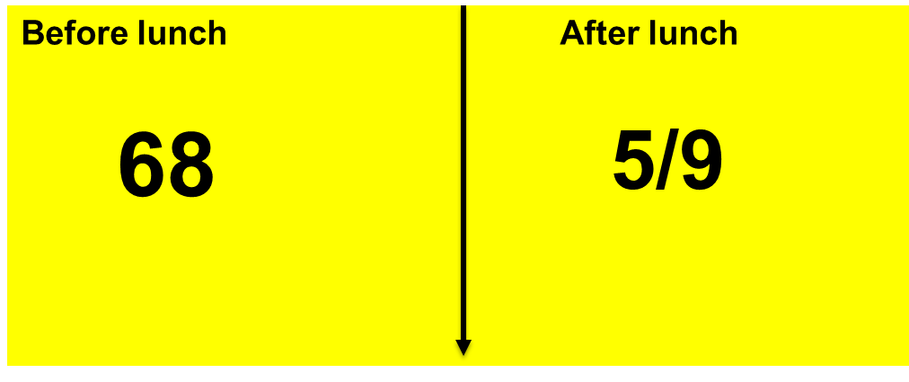
4/9
17
4
68

Slide 13
4/9
5/9
17
4
68
1/9 = 17
17 x 9 = 153 leaflets in total
Which is the same as 4/9 +
5/9 = 9/9

Slide 14
Year 3-6 SPaG knowledge
Year 3 and 4
Prepositions
Adverbs/adverbials
Determiners
Types of nouns
Subordinate clause/conjunctions
Compound sentences
Main clause
Noun phrases
Fronted adverbial
Apostrophes
Prepositional phrase
Brackets
Speech punctuation
Year 5 and 6
Relative clauses
Relative pronouns
Semi colons
Dashes
Colons
Hyphens
Active and passive
Modal verbs
Subjunctive mood
Formal and informal speech
Types of adverbs
Complex sentences
Multi clause sentences

Slide 15
Children are expected to be able to identify the different parts of a sentence:
The daring, athletic diver on the ten-metre board boldly lept off.
This is a simple sentence as it has one main clause.

Slide 16
The ravenous lion pounced, but the gazelle bolted courageously.
A compound sentence is a sentence made up of two main clauses joined together by a coordinating conjunction. Both main clauses would make sense on their own.

Slide 17
Miss Jones, who is our music teacher, always makes us laugh.
A relative clause gives more information about the noun. Sometimes (but not always) they are embedded in the sentence.

Slide 18
Active vs passive voice
In a sentence written in the active voice, the subject of a sentence performs the action.
In a sentence written in the passive voice, the subject receives the action.
Active voice: Tom knocked over the lamp.
Passive voice: The lamp was knocked over by Tom.
Both sentences describe the same action taking place (Tom making contact with a lamp and causing it to fall over) with the first sentence making Tom the subject and the second making the lamp the subject.

Slide 19
Writing expectations for year 5
For a child to reach the expected standard of writing, in year 5, they need to be using all of the SPAG that Mr Pipe has just spoken about apart from the subjunctive mood and passive voice. They have to be using all previously taught punctuation correctly (capital letters, full stops, commas, brackets, exclamation marks and question marks) as well as starting to use high-level punctuation, such as colons and semi-colons.
For every piece of writing we have a success criteria that is set. From the spring term onwards, a year 5 expected piece of writing would be expected to include the following literary strategies.

Slide 20
Writing expectations for year 5
Success criteria
High-level punctuation and vocabulary
SNOT (show not tell)
Personification (p) and pathetic fallacy (pf)
Similes (s) and metaphors (m)
A variety of sentence types
Compound and complex sentences
Subordinate clause sentence starts (SCL start)
Relative clauses (RC)
Fronted adverbials (FA)
To reach exceeding, as well as all the above, children should be using further literary strategies such as irony, the passive voice and they should also be using high level punctuation consistently and mostly correctly throughout all their work. They also need to be using a mature writing style, with original and thoughtful ideas.

Slide 21
Writing expectations for year 6
For a child to reach the expected year 6 standard, they must be able to consistently and accurately use all the SPAG and literacy strategies from year 5 as well as all of the SPAG Mr Pipe spoke about earlier.
Their success criteria would be the same as the year 5 one, but would also contain the following.
Passive voice
A shift in formality
The subjunctive mood. (It is essential that he be rewarded for all of his efforts.)
Verb tenses, with a natural shift in tense
Writing from different viewpoints
For a child to reach the exceeding year 6 standard they must also included the following:
Show a natural and conscious control over formality
To independently choose the appropriate register for their writing
To use all punctuation and HL punctuation correctly, with no mistakes, and be able to spell accurately with little to no mistakes.

Slide 22
VIPERS is an acronym to aid the recall of the 6 reading domains as part of the UK’s reading curriculum.
They are the key areas which we feel children need to know and understand in order to improve their comprehension of texts.

Slide 23
Vocabulary
Find and explain the meaning of words in context.
What do the words ...... and …… suggest about the character, setting and mood?
Which word tells you that….?
Which keyword tells you about the character/setting/mood?
Find one word in the text which means……
Find and highlight the word that is closest in meaning to…….
Find a word or phrase which shows/suggests that…….

Slide 24
Inference
Make and justify inferences using evidence from the text.
Clues (text evidence)
What you already know (prior knowledge)
Form an idea (make an inference)
How do these words make the reader feel? How does this paragraph suggest this?
How do the descriptions of …… show that they are …?
How can you tell that…?
What impression of …… do you get from these paragraphs?

Slide 25
Predict
Predict what might happen from the details given and implied.
From the cover what do you think this text is going to be about?
What does this paragraph suggest will happen next? What makes you think this?
Do you think the choice of setting will influence how the plot develops? Explain your answer using evidence from the text.

Slide 26
Explain
Explain how content is related and contributes to the meaning as a whole.
Explain how meaning is enhanced through choice of language.
Explain the themes and patterns that develop across the text.
Explain how information contributes to the overall experience.
What is the purpose of this text feature?
Is the use of ….. effective?
The mood of the character changes throughout the text. Find and copy the phrases which show this.
What effect does ….. have on the audience?
How does the author engage the reader here?

Slide 27
Retrieve
Retrieve and record information and identify key details from fiction and non-fiction.
How would you describe this story/text? What genre is it? How do you know?
How did…? How often…? Who had…? Who is…? Who did….?
What happened to…?
What can you learn from …… from this section?
The story is told from whose perspective?

Slide 28
Summarise
Summarise the main ideas from more than one paragraph.
Can you number these events 1-5 in the order that they happened?
What happened after …….?
What was the first thing that happened in the story?
Can you summarise in a sentence the opening/middle/end of the story?
In what order do these chapter headings come in the story?

Slide 29
Children should be encouraged to read every day.
Top ten reading benefits for children:
Their vocabulary is larger and more extensive.
They perform better academically.
Their imagination can run wild.
Their creativity skills develop.
They develop empathy.
They gain a deeper understanding of their world.
Their concentration levels improve.
The parent and child bond improves.
Their cognitive development is supported.
Their social skills and interaction improve.
Children should read whatever
they find interesting.
Follow their interests and
allow them to try books they
like.

Slide 30
Marking and Feedback
There are four different elements to marking and feedback:-
Verbal feedback from the teacher.
Marking comments that use 2 stars and 1 wish – the stars are good things the wish a target to aim for next time.
Self-assessment by the pupil against the success criteria set for that lesson.
Peer- assessment by other pupils who use the success criteria set for that lesson to assess the work.
Assessment. Barnston Primary School
.

Slide 31
Planning
Once a lesson is over, the child’s progress will be recorded on the planning for that lesson using initials.
‘This builds up a daily picture of your child’s strengths and weaknesses’.
The teacher then knows who still needs reinforcement in this area of the subject and who is secure and ready to move on.
Teacher’s will keep weekly records from this information and some pupils need intervention for 15 minutes at lunch time.

Slide 32
Identifying strengths and weaknesses is the key!
Identifying the above, means that the teacher can plan to these by grouping the children according to their differentiated needs.
Groups are fluid and arise in response to strong assessments.

Slide 33
Progress Data Termly
All this assessment feeds into individual progress data, termly and whole class percentages of:
Emerging.
Expected.
Exceeding.
The subjects we are required to provide assessment data for individual pupils are reading, writing and maths. We also assess all subjects on planning sheets and gain termly class percentages in emerging, expected and exceeding in all wider subjects.

Slide 34
Pupil Progress Meetings Termly
Data on individual pupils and whole class percentages is presented to J Pearson at the end of each term for each year group.
Teams meet with J Pearson and discuss the data and from the professional discussions and other evidence presented if necessary, i.e. child’s books, planning sheets with assessments on, termly assessment sheets, teacher’s weekly records, judgements on progress are made.

Slide 35
Intervention
Pupils who cause concern from the Pupil Progress Meetings will be put in intervention groups – 6-8 weeks, parents not informed unless worries progress is not being made.
This is children of all abilities, as any child whatever their ability may, at times, make slower progress.

Slide 36
What are Intervention groups?
Small group learning to re-inforce concepts that pupil’s are struggling with.
They last for about 6-8 weeks and the planning is in response to the pupils’ areas for improvement.
Extra support outside of maths, reading and writing sessions – usually take place in lunchtime.
They can be ICT based at times as there are many good intervention programmes using this.
Impact of these is measured and assessment used to ascertain whether the pupil has made enough progress.

Slide 37
Formal Assessments
Every academic year: SATs Y2 and Y6.
EYFS: Early Learning Goals to gain expected (no exceeding).
Y1: Phonics test at the end of the year - government run and results analysed. If pupils do not hit the required ‘met standard’ in Y1 they get another chance in Y2.
Y2 from 2016-22: Government tests in Reading, Writing, Maths, alongside Teacher Assessments.
Y6 from 2016-22: Government tests in Reading, Writing, Maths and English Grammar.
Y6 1970s?-2022: 11+ selective test (not KS2 curriculum and not government led, a test to see who is capable of grammar selective education – but KS2 ‘zips’ into grammar education)

Slide 38
Formal Assessments
The standardised score from the NFER test in Y3 and Y5 will determine whether a child has the ability to sit the 11+ so you should:
Listen to the staff and their expertise.
Not put your child through endless tutoring and pressure if it is not their natural ability.
Realise that there are excellent non-selective high schools in the local area.
If you do decide to go with the 11+ - realise that passing the test is only the start of the hard work and that your child needs to achieve highly at the end of the KS2 curriculum SATs in order to progress to KS3 in all high schools.

Slide 39
NFER Assessments Y3 & Y5
Below 70 children may need lots help and a one-to-one support – called an Education Health Care Plan.
70-85 SEN register needing school extra help.
85-99 May get to expected with help and support.
100-117 Average intelligence band.
117-130 Above average band (11+ candidates)
130+ Well above average
These pupils should be able to meet the standard of the 11+ without being tutored, as the grammar schools want children with natural ability & flair who can achieve with ease – a familiarization test should be all that is needed.

Slide 40
Assessment – 11+
Headteachers throughout the Wirral are given a code of conduct to follow, as this is not a National test – we are not allowed to be involved or help with this – only enquiries and pointing parents to the right place.
Passing the 11+ test does not mean your child does not have to complete and work hard in the KS2 curriculum to the end of Y6 SATs. If they don’t, they have huge gaps.
End of KS2 moves into KS3 curriculum, whether Grammar or non-selective. If your child does not work hard to the end of KS2, they will feel behind at KS3, particularly at Grammar pace.
It is so important that each child reaches their full potential before they leave KS2, as they will be judged against all other Year 7’s at High School.

Slide 41
11+
How we as a school can support you as parents:-
Carry out a Secondary Transfer meeting early spring of Y5 which includes 11+ information.
Support you by applying for any SEN extra time by Mid June of Y5 – parents to contact the headteacher.
Support you with parent appeals with attendance information and predicted scores for the end of Y6, if your child does not meet the standard.
Listen, understand and support you and your child.

Slide 42
SAT’S STANDARDISED ASSESSMENT TESTS
These are at the end of Year 2 and Year 6.
Why are the Y2 and Y6 tests important?
The year 2 results give all schools the expected projection for year 6.
Children can be tracked and pushed on towards their year 6 target or beyond.
Year 6 results are fed into high school and used for setting – grammar schools included.
If children meet the standard for Grammar in September and yet cannot gain a solid expected/exceeding in Y6 SATs, then they are not grammar school ready or other High School ready.

Slide 43
Why are we well positioned at Barnston to get your child to the expected standards or beyond?
The government are expecting 90% to meet the expected standard in Y6 by 2030 in each subject. This year, following a two year pandemic, we gained 90% in reading, mathematics, English Grammar and Science at the end of Y6. Our exceeding results were way above Wirral and National in 2022 and for 8 years previously – so our curriculum works.
Staff and governors are committed to change and are always aspiring to push standards even higher.
We are not just focused on academia, but develop and celebrate the whole child – meeting their social and emotional & SEN needs.

