Slide 1
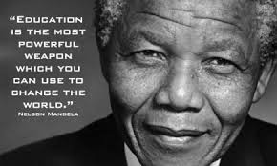
Welcome to Year 5/6!

Slide 2
The team!
Miss Nichols
Miss Tobin
Miss Wright

Slide 3
Dear Parents/Carers,
I am Miss Nichols and I am head of Upper Primary. I have a wonderful team of children, teachers and teaching
assistants and each one of us is fully committed to every child that walks into our classroom – our career choice was definitely not an accident or because we didn’t quite know what we wanted to do. It was a deliberate decision we made, to impact the lives of many children and give them the best possible start to their educational lives! We love our job!
Our job is a tough one. We work with the children to help them reach their full potential – no stone is left unturned and we believe EVERY child matters. Each child leaves us with pride and success. In doing this, every child is taught at their own ability, making the strides of progress they are capable of. We don’t let children develop lazy habits or a poor attitude – with this comes tough love! They may moan at the start, but by the end they are dancing in the corridors with the achievements they have obtained! As I say to the children, “I love you, but I will not let you away with anything and you will thank me for this when you are 18!” We want them to feel proud, successful, driven and motivated – all in the huge task of getting them ready for a world that we never grew up in. I always include my favourite quote in my transfer meeting because, quite simply, it is true.
We are biased, but we believe that Upper Primary are the best years in primary school and that they grow and change so much – they literally transform!
Safe to say, we start each year with excitement of the challenge ahead, the achievements to be got, the work to be done and the lovely children – your lovely children who come to us! We can’t wait to meet you all!
Miss Nichols, Miss Wright and Miss Tobin
P.S. As you saw earlier, we teach by day, but at night we fight for the greater good!

Slide 4
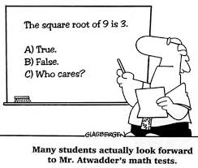
Class structure
There are 3 mixed Y5/6 classes –
-these classes are mixed by gender and ability. These are the 3 Y5/6 classes which the children learn in, apart from when they go to their Maths classes.
There are 3 Maths classes based upon ability and pace – There is 1
straight Y6 class. Then there are two others - 1 mixed Year 5/6 class and
1 Year 5 class. These classes are set on ability and pace.
We work very closely as a team and constantly discuss all
of the children – we all know each other’s children well!
We moderate all of the children’s work in terms of age-
related standards. We moderate Year 6 work in terms of
reaching the Secondary Ready standard.

Slide 5
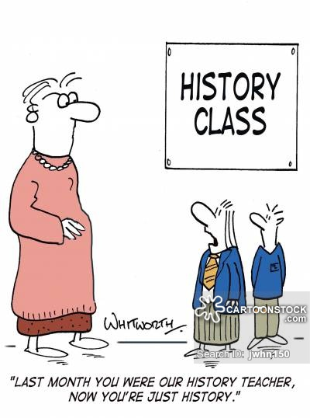
Topics for 2020-2021
World War 2 and Britain since
the 1930s
The Ancient Greeks
Rivers and a local area study

Slide 6
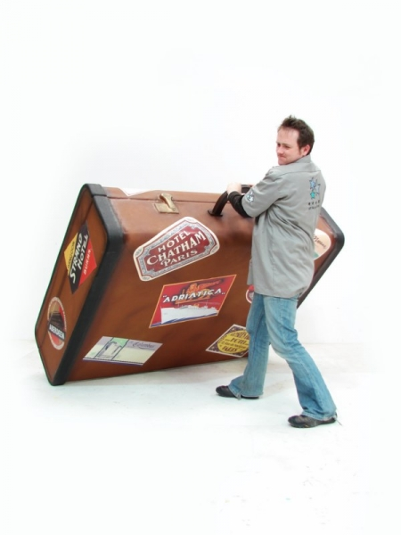
Kit list!
It is really important that they are equipped for each lesson and
don’t go to Maths without all of the equipment they need!
A pencil case with relevant tools including a red pen or two;
a rubber; a glue stick (preferably Pritt Stick) and
a few pencils. We provide handwriting pens.
Barnston P.E. kit – this is on the website
Indoor P.E. kit is a white t-shirt or Barnston t-shirt;
a pair of navy/black shorts or white, pumps (no trainers or tights)
Outdoor P.E kit is as above, but with trainers.
In colder weather, the children may wear navy or black joggers.
Strictly no football kits are allowed at any time. Should a child not have the
correct kit, they will not be joining the P.E. lesson and will be given
work to do in a different classroom.

Slide 7
Homework
Homework is so important. Over the years, I have witnessed children make so much progress when they are
committed to doing homework. This is because it embeds concepts taught that week – it is never set for the
sake of it.
Spellings –learn and tested on a Friday. Children should be using the look, write, cover, check spell method to learn them and embed them into the long term memory
Spelling, punctuation and grammar is given as we feel necessary
Maths – hard copy homework, times tables rock stars and My Maths weekly
Comprehension – every 2 weeks
We also give out topic related homework when necessary

Slide 8
Interventions and extra support
We provide interventions to help and support children to keep up with the fast pace of learning in a tough curriculum.
We aim to help children to close gaps in understanding.
We want them to be reaching their own potential and we believe this really positively impacts self-esteem.

Slide 9
SATs tests at the end of KS2
You will have no doubt heard of SATs tests - they now appear a lot in the media in recent years. Whilst these tests are not the be all and end all, the children are prepared thoroughly for them. This is for a number of reasons:
Tests are a fact of life. They will sit G.C.S.Es/A Levels/Degree/Professional exams potentially. They need to get used to the formal education that the UK has. This is not changing or going away.
The more progress they make in primary school, a better start they will have in secondary. It is a fact. If they achieve their full potential in primary, they will be in a good position once they change schools and instead of worrying about being behind, they can concentrate on settling in and getting used to the change.
Parents will say to me, “What is the point. They sit other tests when they get to Y7.” Well, there is a point. The better they do at primary, the better they will do in the tests in Y7 if that is the school’s procedure used to set them. Other schools will use the SAT results to put them in classes, along with what we report in terms of effort and attitude.

Slide 10
3. Therefore, it is the system us and the children deal with. At Barnston, we do not coach towards a test. There is no point - it is a waste of time. It simply means learning is not embedded in the long term memory and can’t be applied. We have never bought into this. We have a broad and balanced curriculum and always have done. The fact is, if the teaching is outstanding and the children are doing what they should be doing, the results follow. We are not driven by results, but progress of each child at their ability.
4. The skills that your child needs to develop are very much interwoven with our curriculum, but also with this process. The process demands independence, motivation, problem solving and responsibility.
5. We have to give reports to secondary schools on what level your child is working at and if we say they are working at the age-related standard or above and this does not reflect in the SATs, the secondary schools have much more work to do, to try and get them to where they thought they where.
6. I have had requests that parents do not want their child stretched in class - challenged with harder work, if they are capable. In my view, this is simply putting a child in a position where they are going to fall behind which damages self esteem. This is not our vision. Barnston has a work ethic which is roll your sleeves up, work your socks off and feel successful!

Slide 11
We believe these are the best years of their school lives!
They grow as people
They grow in confidence
They learn life skills
They become more mature
They develop a love of learning
And above all…………………………………………………..

Slide 12
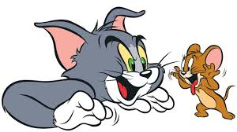
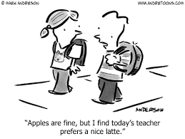
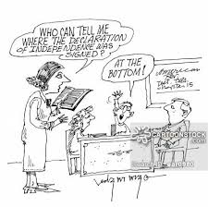
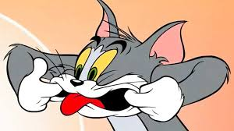
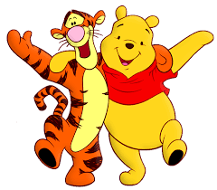
They have FUN!

